Slide 1
WEB 322 WEB PROGRAMMING TOOLS AND FRAMEWORKS
Week 5 - Lecture 1
Git, GitHub & Web Hosting

Slide 2

What is Git?
Initially created by Linus Torvalds for development of the Linux Kernel.
It is a version control system for:
tracking changes in computer files.
coordinating work on those files among multiple people.
It is primarily used for source code management in software development.
Git is not GitHub:
Git: the version control software, download from https://git-scm.com/
GitHub: a Git repository hosting service. This is where you upload your Git repository.

Slide 3
Distributed Development
Allows multiple people to work on the same project at the same time.
Without version control, it is difficult to work on the same file as someone else, why?
A single change to a file will overwrite the master code file when committing.
Git can find changes and push only those changes made.

Slide 4
Safeguard
Every file saved in Git is accessible, even if you delete it.
There is always a record of your save history.
It is tough to corrupt your code whether it occurs accidentally or maliciously, and if you do, you can revert to a point in time.

Slide 5

Core Concepts of Git
The Repository (or Repo)
Commits
Branches

Slide 6

The Repository (or Repo)
Just "repo" for short.
Represents a container.
This typically contains your website, web application, or project folder.
Git doesn't operate on your entire filesystem:
It's limited to a single directory.
Includes the sub-directories of that directory (recursively).
The root of the repository contains a “.git” folder:
It stores all of Git's internal files.
Run the git init command to initialize the folder as a Git repo.
You must have Git installed on your machine.

Slide 7

Commits
A snapshot of the state of the repository.
It stores the contents of every file at the time of the commit.
Committing changes will happen frequently throughout the development of your site or application.
Frequent commits means:
You can track the progress of development.
Roll back if necessary. For example, in case of a major bug.
Commits:
Make up the history of your project.
Are visible to anyone viewing your remote repository.
Usually mark the completion of some logical unit of work.

Slide 8
3 Areas of a Git Repo
Working Tree
Staging Area
Local Repository (History)

Slide 9
Working Tree
The workspace (or working directory) containing files and folders in a repository. It is where your files live.
Any changes to files will be marked and displayed in the Working Tree but they are not tracked until you tell Git to track them.
Excludes the .git folder.
If you make changes to files:
Git will recognize the files are modified.
Git will not act until you tell it to.
If changes are not saved to Git, you will lose the changes made to your files.

Slide 10
Staging Area
You tell Git the specific files you want tracked in a staging area.
Git then starts tracking and saving changes that occur in files.
These saved changes are reflected in the .git directory.
If you make additional changes after adding a file to the Staging Area, Git will not know about those specific changes until you tell it to see them.
Only the changes in the staging area are put in the next commit.
Commands
git status – Shows you what is in the staging area.
git add filename – Adds a particular file to the staging area.
git add . – Adds all files from the working tree to the staging area with the exclusion of what is inside the .gitignore file

Slide 11
Local Repository
The Local Repository (or Git History) contains everything in your .git directory.
In other words, your Local Repository contains all your checkpoints or commits.
To add items from your Staging Area to your Local Repository use the command:
git commit -m “Put a comment about the commit”
The command will take all changes in the Staging Area, wraps them together and puts them in your Local Repository.
A commit is simply a checkpoint telling Git to track all changes that have occurred up to this point, using your last commit as a comparison.
After committing, your Staging Area will be empty.
git log - This command shows all previous commits in the repo.

Slide 12
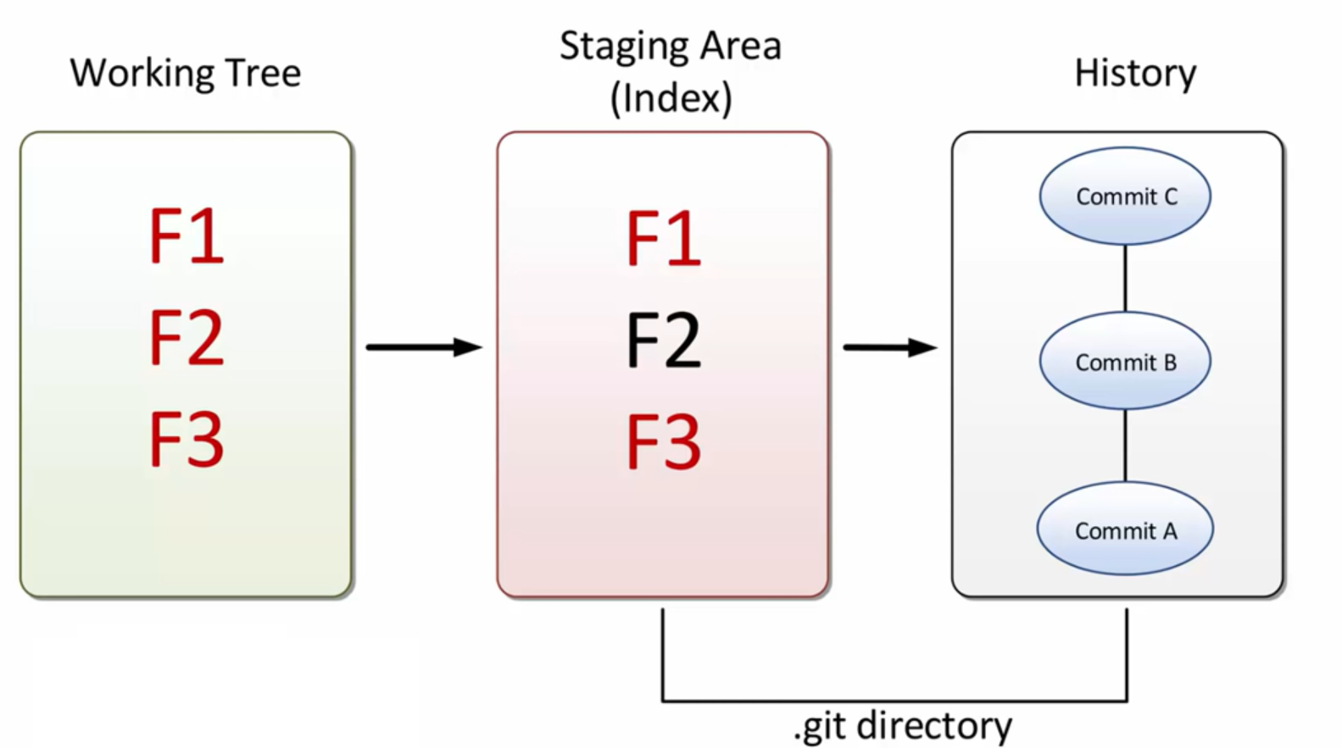

Slide 13
Popular Git Commands
git init
Initializes a folder as a Git repository. Creates a hidden folder named .git that will hold all the transactions and history for your project.
git add .
Add all files to your staging area.
git add “filename.ext”
Add a single file to your staging area.
git status
Check the status of your repository.
Displays the state of the working tree and the staging area.
It shows the files that have been staged, not staged, and the files tracked by Git.

Slide 14
More Git Commands
git commit -m “__________”
Commit all the files in the staging area.
Specify some comment to show in the commit history.
git log
View the commit history.
git diff
Show the code changes between your working tree and your staging area.
git checkout “commit ref”
Navigate between commit history

Slide 15



Git Cloud Hosting Services

Slide 16
Git Cloud Hosting Services
Github, Bitbucket and Azure DevOps:
Are 3rd party cloud services offering storage for repository files.
Not directly affiliated with Git in any way.
Offer visual tools for management of the code and its history.
Offer tools for teams to remotely collaborate on their code.
Create a GitHub Account: https://github.com/
Create a Bitbucket Account: https://bitbucket.org/
Create an Azure DevOps Account: https://dev.azure.com/

Slide 17
Remote Repository
Git repositories and their entire history lives on your local computer.
For collaborating, sharing, or backing up your code to the cloud, a remote repository is necessary.
Github is a service that provides hosting space and graphical interface tools for Git repositories.

Slide 18
Git Commands (Remote Repository)
git remote add origin master remoteURL
Create a link between your local repository and the remote repo.
git push -u origin master
Push committed files from the local repo to the remote repo.
Used for initial commit.
git push origin master
Push committed files from the local repo to the remote repo.
Used for remainder of commits.

Slide 19
Git Commands (Remote Repository)
git clone remoteURL
Clone a remote repository.
Use if you want to pull a copy of an existing Git repository.
For example, pull a project you'd like to contribute to.
git pull origin master
Pull new data (changes) from a remote repository.
Integrates the changes into your current working directory.

Slide 20
Git Commands (Remote Repository)
git remote -v
Displays information about the remote repositories attached to your local repository.
git remote rm remotename
Detach a remote repository from your local repository.

Slide 21
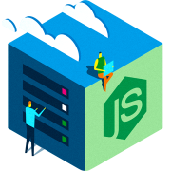
Web Hosting

Slide 22
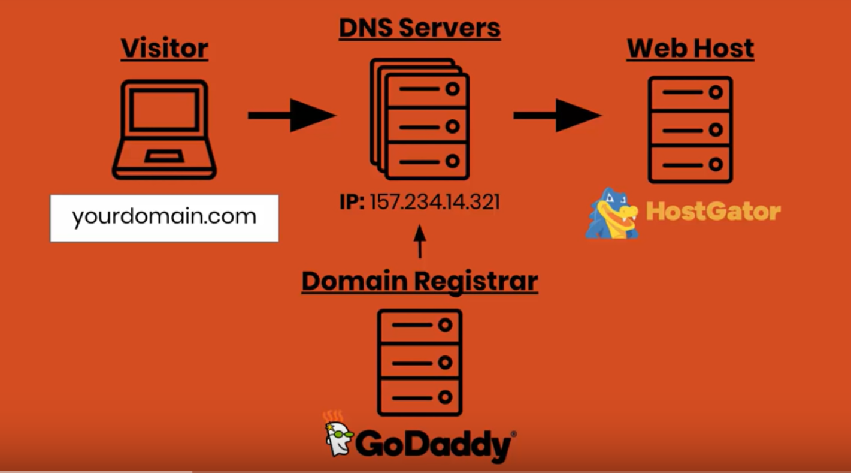
How Websites Work

Slide 23
Types of Web Hosting
Shared Hosting
Pros: Cheap, quick and easy to setup.
Cons: Slow, limited to no control.
Virtual Private Server (VPS) Hosting
Pros: More control.
Cons: May be pricey and doesn’t scale as easy.
Dedicated Hosting
Pros: Very fast, great control.
Cons: Very expensive.
Cloud Hosting
Pros: Fast and scalable (scale up or out).
Cons: More expensive than shared hosting but more control too.

Slide 24



Cloud Based Hosting

Slide 25


